Slide 1
Introduction to Deep Reinforcement Learning
B. Ravindran
Reconfigurable and Intelligent Systems Engineering (RISE) Group
Department of Computer Science and Engineering
Interdisciplinary Laboratory for Data Science (ILDS)
Indian Institute of Technology Madras
Aravind Srinivas L., Sahil Sharma, Janarthanan R., Prasanna P., Ramnandan K., Peeyush Kumar, Vimal Mathew
Mitesh Khapra

Slide 2
Outline
Basics:
Reinforcement Learning
Deep RL
Fine Grained Action Repeat
Attend, Adapt and Transfer
Hierarchical RL with deep representations
Conclusions

Slide 3
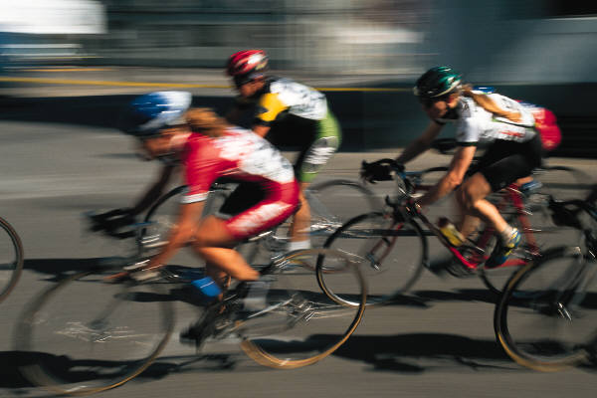
Reinforcement Learning
A form of Trail-and-Error learning
Limited scalar evaluation/rewards
Falling down hurts
Learn to maximize long-term performance

Slide 4
Full RL Framework
Environment
evaluation
State
Action
Agent
Learn from close interaction
...with a stochastic environment
...having noisy delayed scalar evaluation
...with a goal to maximize a measure of long term performance
Notes:
Benefits of RL.Applications.
Future rewards.
Situate in literature.. AI.
Stochastic systems.
Connections to OR.

Slide 5
Not Supervised Learning!
Input
Output
Agent
Error
Target
Very sparse “supervision”
No target output provided
No error gradient information available
Action chooses next state
Explore to estimate gradient – Trail and error learning

Slide 6
Not Unsupervised Learning
Input
Activation
Agent
Evaluation
Sparse “supervision” available
Pattern detection not primary goal

Slide 7


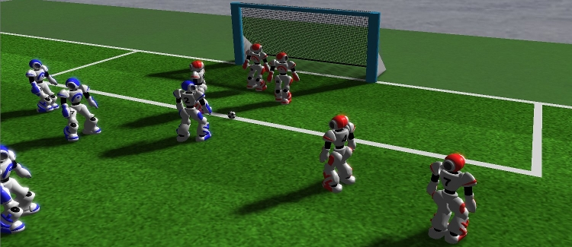
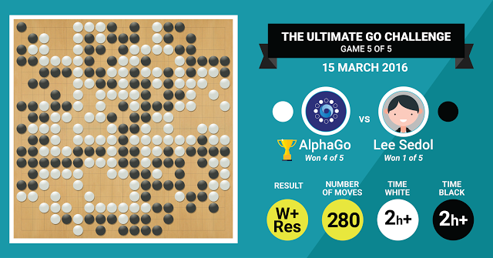
RL Applications

Slide 8


Autonomous Control

Slide 9
Other Applications
Optimal Control
Robot Navigation
Chemical Plants
Combinatorial Optimization
Elevator Dispatching
VLSI placement and routing
Job-shop scheduling
Routing algorithms
Call admission control
More
Intelligent Tutoring Systems
Computational Neuroscience
Primary mechanism of learning
Psychology
Behavioral and operant conditioning
Decision making
Operations Research
Approximate Dynamic Programming
More
Dialogue systems

Slide 10
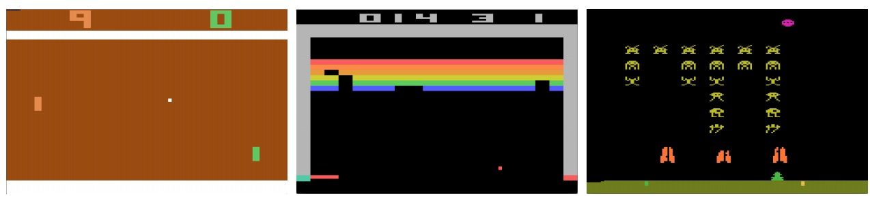
Homage to Deepmind
Atari
Alpha GO
Probably what draws an audience to a RL Talk

Slide 11
Arcade Games Mnih et al., Nature 2015
Learnt to play from video input
from scratch
Used a complex neural network!
Considered one of the hardest learning problems solved by a computer.
More importantly reproducible!!

Slide 12
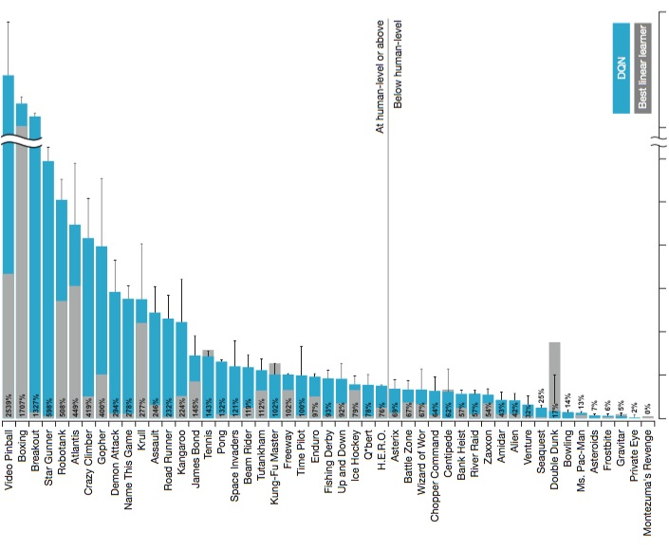

Slide 13
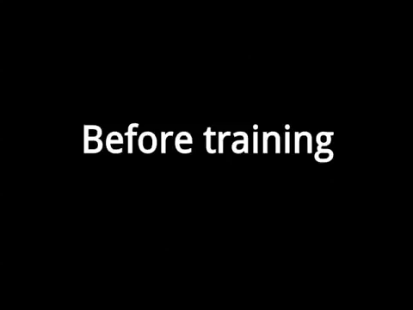
Deepmind’s Atari Player

Slide 14
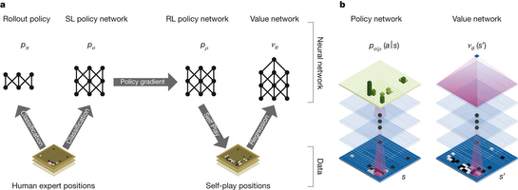

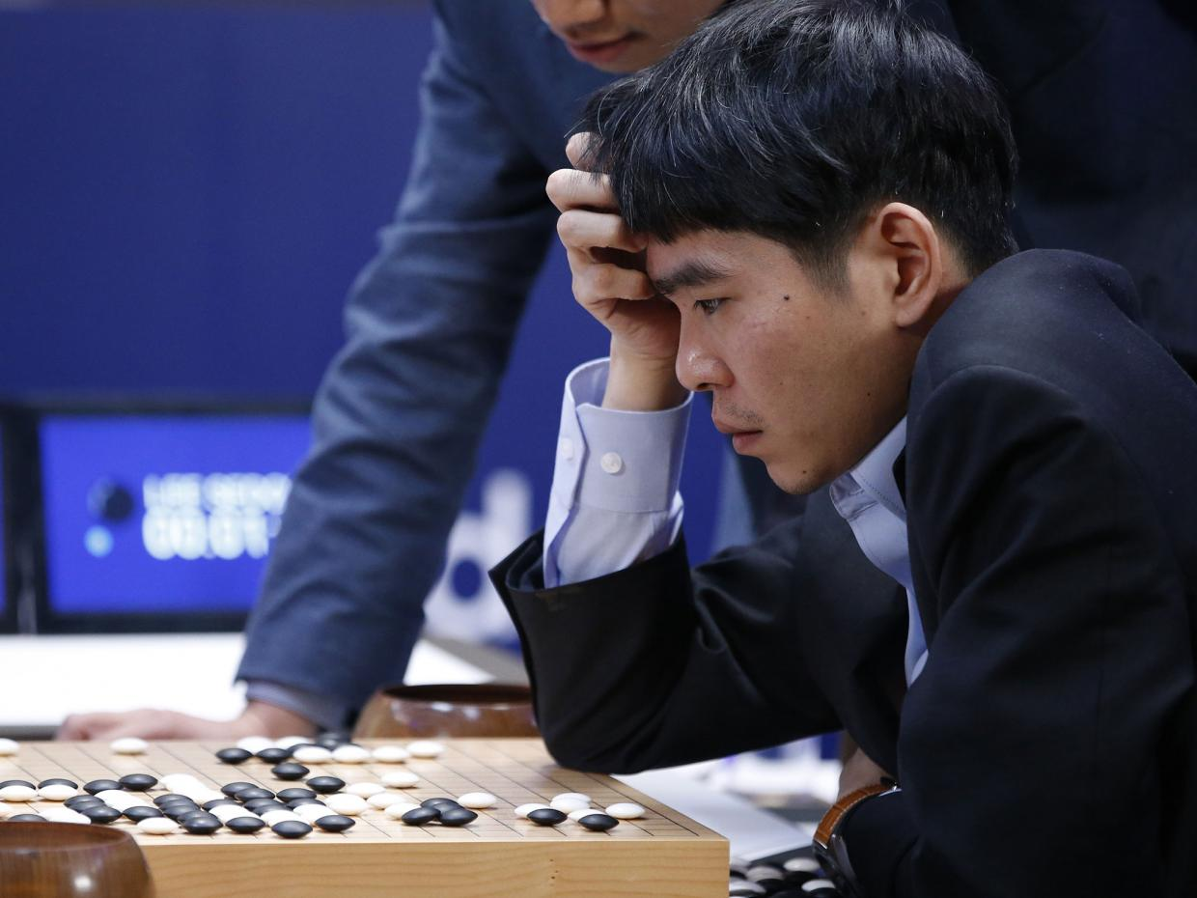
Mastering the game of Go Silver et al., Nature 2016

Slide 15
Alpha Go Silver et al., Nature 2016
Retired from Active Competition last week
after beating the highest ranked human player!

Slide 16
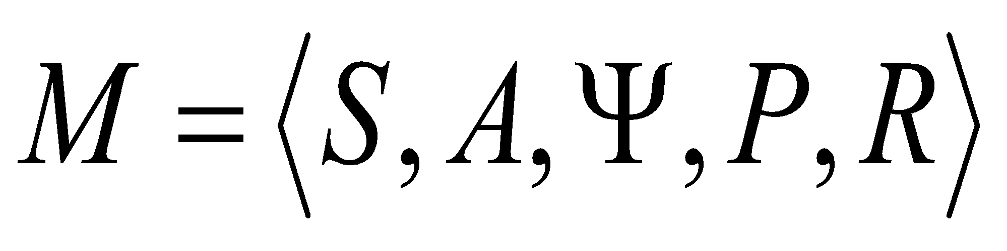
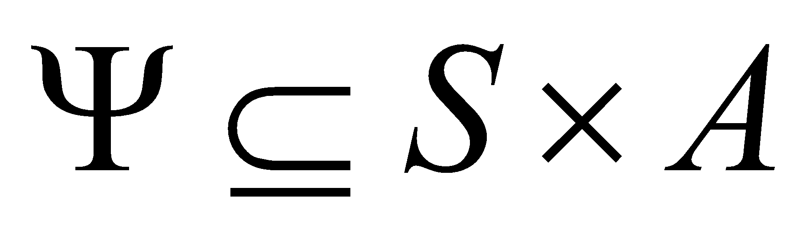
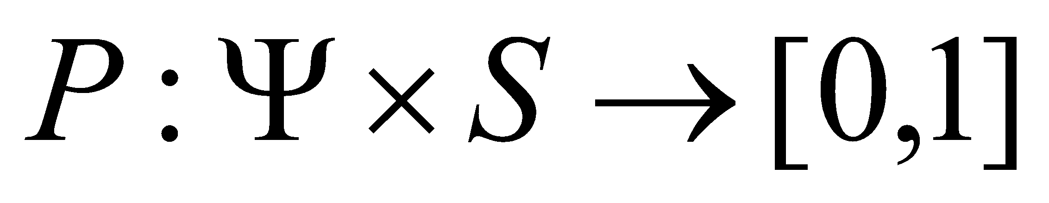
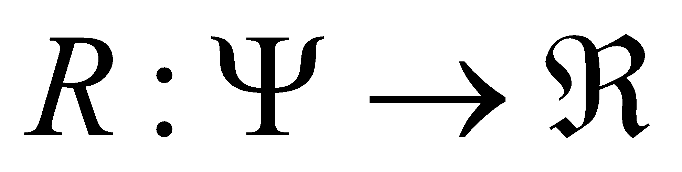

Markov Decision Processes
MDP, M, is the tuple:
S : set of states.
A : set of actions.
: set of admissible state-action pairs.
: probability of transition.
: expected reward.
Policy (can be stochastic)
Maximize total expected reward
Learn an optimal policy

Slide 17
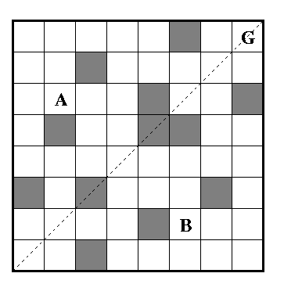
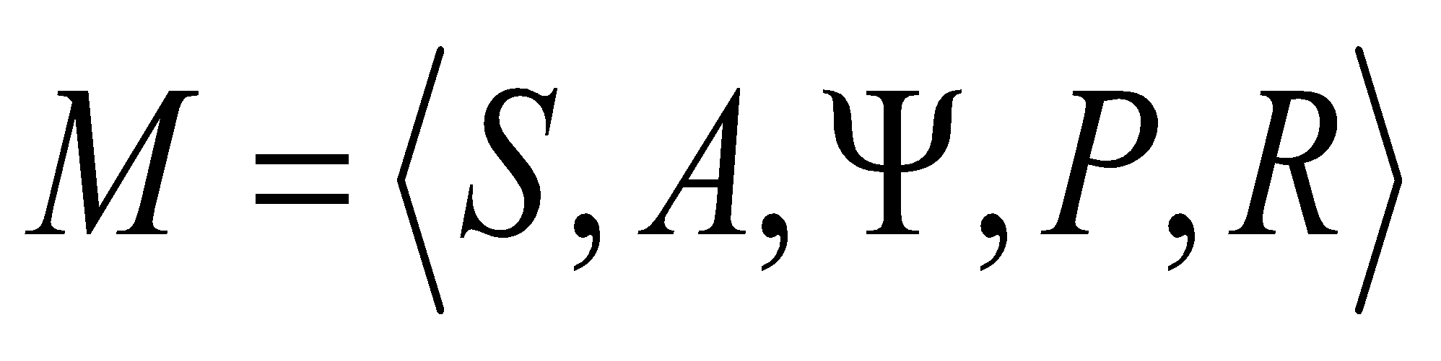
MDP Example
N
W
E
S

Slide 18
The Agent-Environment Interface
. . .
r
t +1
r
t +2
r
. . .
s
s
t +1
s
t +2
t +3
s
t +3
t
a
a
t +1
a
t +2
a
t
t +3

Slide 19
The Agent Learns a Policy
Reinforcement learning methods specify how the agent changes its policy as a result of experience.
Roughly, the agent’s goal is to get as much reward as it can over the long run.

Slide 20
Goals and Rewards
Is a scalar reward signal an adequate notion of a goal?—maybe not, but it is surprisingly flexible.
A goal should specify what we want to achieve, not how we want to achieve it.
A goal must be outside the agent’s direct control—thus outside the agent.
The agent must be able to measure success:
explicitly;
frequently during its lifespan.

Slide 21
Returns
Episodic tasks: interaction breaks naturally into episodes, e.g., plays of a game, trips through a maze.
where T is a final time step at which a terminal state is reached, ending an episode.

Slide 22
Returns for Continuing Tasks
Continuing tasks: interaction does not have natural episodes.
Discounted return:

Slide 23
Value Functions
Expected future rewards starting from a state (or state-action pair) and following policy π

Slide 24
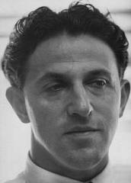
Bellman Equation for a Policy π
The basic idea:
So:
Or, without the expectation operator:

Slide 25
Solving RL problems
Learn an optimal policy – a mapping from states to actions such that no other policy has a higher long term reward

Slide 26
Optimal Value Functions
For finite MDPs, policies can be partially ordered:
There is always at least one (and possibly many) policies that is better than or equal to all the others. This is an optimal policy. We denote them all π*.

Slide 27
Optimal Policies
N
W
E
S
Many optimal policies possible
Unique optimal value function
Expected utility from a state when acting optimally

Slide 28
Optimal Value Functions
For finite MDPs, policies can be partially ordered:
There is always at least one (and possibly many) policies that is better than or equal to all the others. This is an optimal policy. We denote them all π*.
Optimal policies share the same optimal state-value function:

Slide 29
Solving RL problems
Learn an optimal policy – a mapping from states to actions such that no other policy has a higher long term reward
Can learn such a policy directly
Or through estimating an optimal value function
Optimal Value function: The estimated long term reward that you would get starting from a state and behaving optimally

Slide 30
Bellman Optimality Equation for V*
The value of a state under an optimal policy must equal
the expected return for the best action from that state:
is the unique solution of this system of nonlinear equations.

Slide 31
Bellman Optimality Equation for Q*
is the unique solution of this system of nonlinear equations.

Slide 32
Why Action Value functions?
Let Q*(s,a) be the expected value of starting in state s and doing action a and behaving optimally thereafter.
Given the optimal value function one can recover the optimal policy easily

Slide 33
Q-Learning
An incremental learning algorithm
Doesn’t need knowledge of the systems dynamics
Fully incremental
Learn through interaction with a system
. . .
r
t +1
r
t +2
r
. . .
s
s
t +1
s
t +2
t +3
s
t +3
t
a
a
t +1
a
t +2
a
t
t +3

Slide 34
Q-Learning
An incremental learning algorithm
Doesn’t need knowledge of the systems dynamics
Fully incremental
Learn through interaction with a system
. . .
r
t +1
r
t +2
r
. . .
s
s
t +1
s
t +2
t +3
s
t +3
t
a
a
t +1
a
t +2
a
t
t +3
Temporal
Difference

Slide 35
Solution Methods
Temporal Difference Methods
TD(λ)
Q-learning
SARSA
Actor-Critic
Policy Search
Policy Gradient Methods
Evolutionary algorithms
Model based methods
Stochastic Dynamic Programming
Bayesian approaches

Slide 36
Policy Search Methods
Policy search: Instead of maintaining estimates of value functions, search in the space of policies.
Why?
Simpler description
Better convergence
Robust to partial observability
Direct policy search
Genetic algorithms
Policy Gradient Approaches
Notes:
e.g. for simpler form: Threshold policies for inventory control.
e.g. for well behaved policy gradient methods with function approx: You can view the weights of a neural network as the parameters of the policy and under mild regularity conditions, they can be shown to converge.

Slide 37
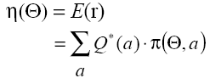
Policy Gradient Methods
Policy depends on some parameters Θ
– Action preferences
– Mean and variance
– Weights of a neural network
Modify policy parameters directly instead of estimating the action values
Maximize:
Simplified Setting
Immediate Reward or
Multi-arm bandits

Slide 38

Multi-arm bandit
n-arm bandit problem is to learn to preferentially select a particular action (arm) from a set of n actions (1, 2, 3, . . . . , n)
Each selection results in Rewards, with noise
Sometimes you get a reward, sometimes don’t
Pick arm that has the highest expected reward

Slide 39
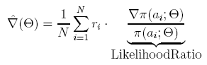
Stochastic Gradient Descent
Computing gradient of performance w.r.t. parameters:
Estimate the gradient from N samples:
Notes:
In Chapter 2 we took a brief look at a policy gradient approach for non-associative problems, like the n-armed bandit task. Here is a brief recap of that.
Gradient expression related to importance sampling
Gradient estimate is an unbiased estimate

Slide 40
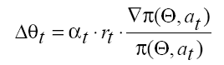
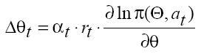
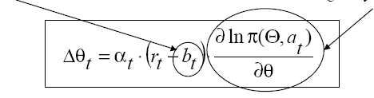
REINFORCE (Williams ’92)
Incremental version:
Reinforcement Baseline
Characteristic Eligibility
Notes:
α independent of action
b_{t} conditionally independent of actions given Θ

Slide 41
Monte-Carlo Policy Gradient
Samples are entire trajectories
s₀, a₀, r₁, s₁, a₁,r_{2,} . . . , s_{T}
Evaluation criterion is the return along the path, instead of immediate rewards
The gradient estimation equation becomes:
where, R_{i}(s₀) is the return starting from state s₀ and p_{i}(s₀;Θ) is the probability of i^{th} trajectory, starting from s₀ and using policy given by Θ.

Slide 42
MC Policy Gradient contd.
The “likelihood ratio" in this case evaluates to:
Estimate depends on starting state s₀. One way to address this problem is to assume a fixed initial state.
More common assumption is to use the average reward formulation.
(1)
Notes:
Example for fixed initial state: Starting board configuration in games like backgammon, chess etc.

Slide 43
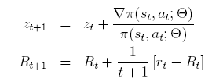
Incremental Update
We can incrementally compute the summation in Equation 1, over one trajectory as follows:
z_{T} is known as an eligibility trace. Recall the characteristic eligibility term from REINFORCE:
z_{T} keeps track of this eligibility over time, hence is called a trace.

Slide 44
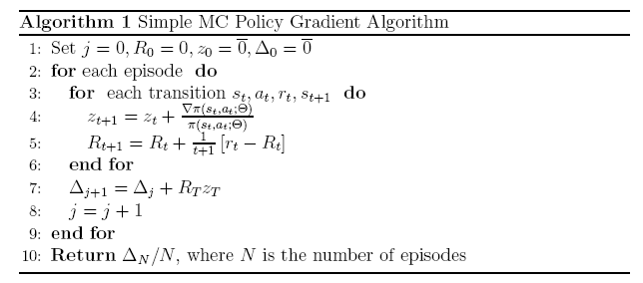
Simple MC Policy Gradient Algorithm
Adjust Θ using a simple stochastic gradient ascent rule:
where α is a positive step size parameter.

Slide 45
Simple MC Policy Gradient Algorithm
The algorithm computes an unbiased estimate of the gradient.
Can be very slow due to high variance in the estimates.
Variance is related to the “recurrence time" or the episode length.
For problems with large state spaces, the variance becomes unacceptably high.

Slide 46
Need for Generalization
Issues with large state/action spaces:
tabular approaches not memory efficient
data sparsity
continuous state/action spaces
We need methods that can generalize experience gained over a limited subset of the state space
Use a parameterized representation

Slide 47
Need for Deep RL
Issues with large state/action spaces:
tabular approaches not memory efficient
data sparsity
continuous state/action spaces
Use a parameterized representation
Value Functions
Policies
Models

Slide 48
Value Function Approximation
Least squares
But we don’t know the target!
Use the TD target.

Slide 49
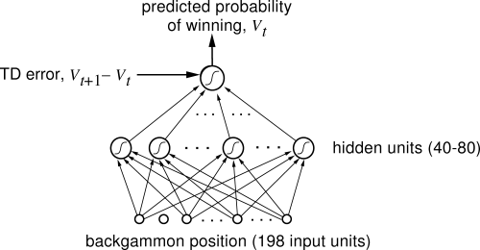
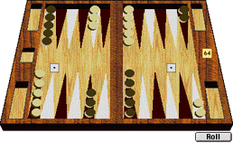
Human Level Backgammon player TD-Gammon (Tesauro 92)

Slide 50
What about Control?
Learnt to play from video input
from scratch
Used a complex neural network!
Considered one of the hardest learning problems solved by a computer.
More importantly reproducible!!

Slide 51
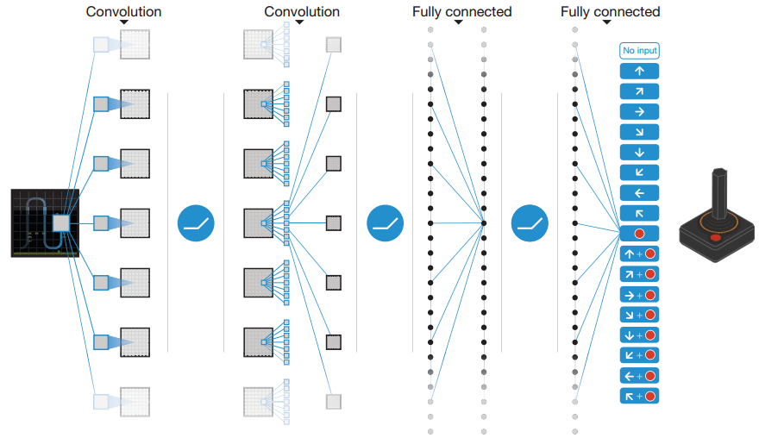
Deep Q-Learning
Source: Deep Q Networks, Nature 2015

Slide 52
Deep Q-Learning
Feature Learning
Source: Deep Q Networks, Nature 2015

Slide 53
Deep Q-Learning
Feature Learning
Linear FA!
Source: Deep Q Networks, Nature 2015

Slide 54
Q-Network Learning
Divergence is an issue since the current network is used decide its own target
Correlations between samples
Non-stationarity of the targets
How do we address these issues? Experience Replay Freeze target network

Slide 55
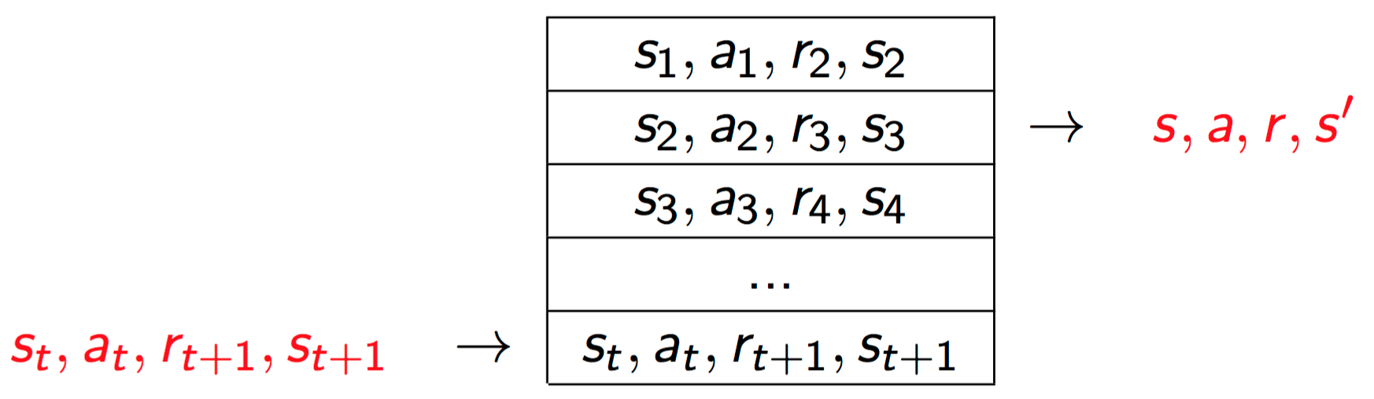
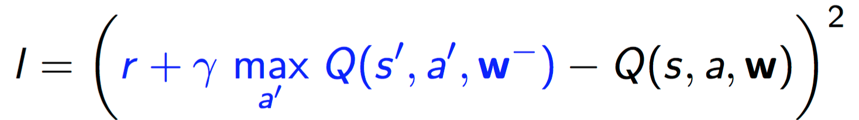
Q-Network Learning
To remove correlations, we build data-set from the agent’s experience
Sample experiences from dataset; w- frozen (with periodic updates) to address non-stationarity

Slide 56
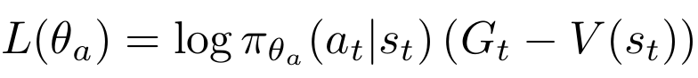
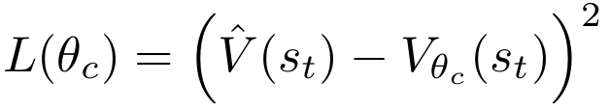
Asynchronous Advantage Actor Critic Mnih et al, 2016
A3C is a recent DRL algorithm for learning policies for sequential decision making on CPUs
It consists of an actor or policy which maps states to probability distribution over actions
And a critic or value function which evaluates the cumulative expected discounted return from state s_{t}
The critic tracks the actor and is used to identify better actions for a given state.

Slide 57
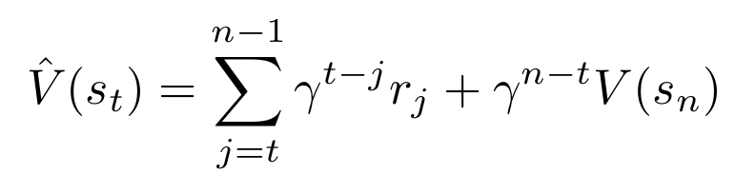
Asynchronous Advantage Actor Critic
Objective functions are:
Sum of rewards obtained on a trajectory
n-step truncated
corrected return
Empirically found
n=20 is the best

Slide 58
Asynchronous Advantage Actor Critic
Advantage Function
Objective functions are:
n-step truncated
corrected return
Empirically found
n=20 is the best

Slide 59
Compare to REINFORCE
Reinforcement Baseline
Characteristic Eligibility

Slide 60
Attention Mechanism
Frequently deep learning networks have too many parameters to learn
Having them attend to only one portion of an input at a time can reduce the complexity
And improve performance
But typically there is no easily obtainable training signal for the attention
Use Reinforcement Learning

Slide 61
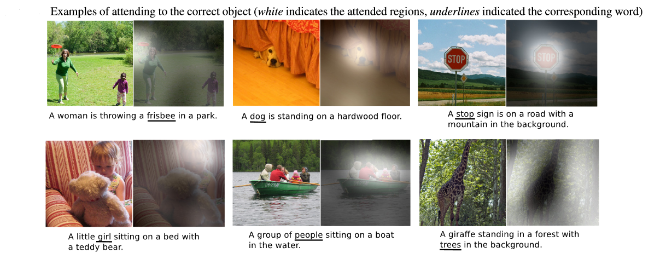
Show, attend and tell
( K. Xu, J. Ba, R. Kiros, A. Courville, R. Salakhutdinov, R. Zemel, and Y. Bengio. Show, attend and tell: Neural image caption generation with visual attention )

Slide 62
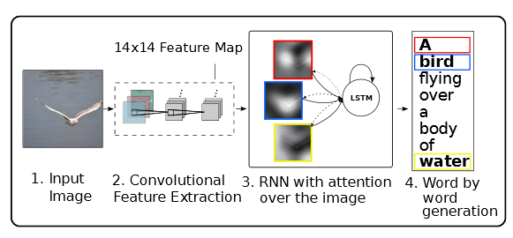
Show, attend and tell
( K. Xu, J. Ba, R. Kiros, A. Courville, R. Salakhutdinov, R. Zemel, and Y. Bengio. Show, attend and tell: Neural image caption generation with visual attention )

Slide 63
Neural Machine Translation
Take advantage of recent developments in neural networks
Train a single large neural network to achieve objective
Classical approaches have several subcomponents, optimized separately
Comparable to state of the art!

Slide 64
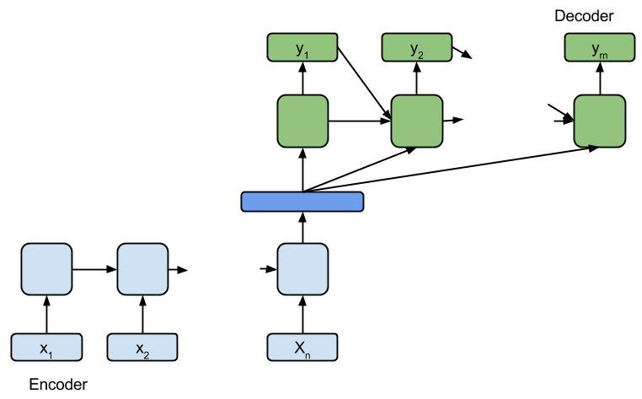
Neural Machine Translation
Encoder-Decoder Model
( Cho, K., van Merrienboer, B., Gulcehre, C., Bougares, F., Schwenk, H., and Bengio, Y. (2014a). Learning phrase representations using RNN encoder-decoder for statistical machine translation )

Slide 65
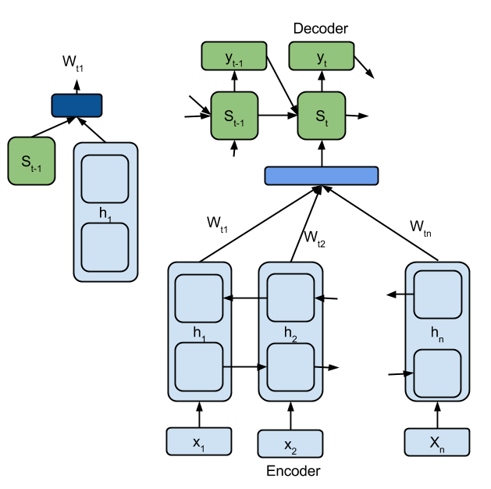
NMT by Jointly Learning to Align and Translate
( D. Bahdanau, K. Cho, and Y. Bengio. Neural machine translation by jointly learning to align and translate )

Slide 66
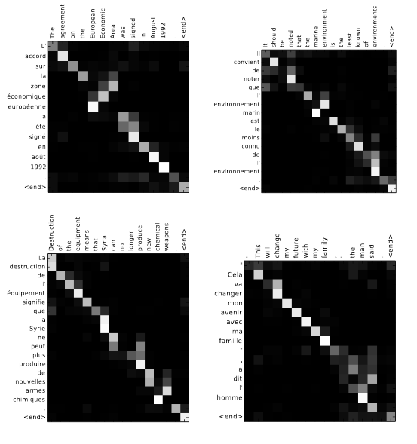
Alignments learnt by the attention mechanism of RNNsearch50.
NMT by Jointly Learning to Align and Translate
( D. Bahdanau, K. Cho, and Y. Bengio. Neural machine translation by jointly learning to align and translate )

Slide 67
Role of RL
Learn the weights of the attention function
Success stories:
Show, Attend and Tell
DRAW: Image generation (Gregor et al.)

Slide 68
Learning Structured Policies with Deep Reinforcement Learning
B. Ravindran
Reconfigurable and Intelligent Systems Engineering (RISE) Group
Department of Computer Science and Engineering
Interdisciplinary Laboratory for Data Science (ILDS)
Indian Institute of Technology Madras
Aravind Srinivas L., Sahil Sharma, Janarthanan R., Prasanna P., Ramnandan K., Peeyush Kumar, Vimal Mathew
Mitesh Khapra

Slide 69
Structured Policies
Explore structure in policy space
Can take many forms
Actions repeated in chunks FiGAR
Smoother motion
Reuse earlier solutions A2T
Transfer Learning
Need a switching policy
Decompose into sub-problems
Skill acquisition
Treat skills as actions

Slide 70
Why Deep RL?
Need a complex problem domain to explore effectiveness of structure in policies
RL largely limited to small toy domains
Deep RL allows us to look at large toy domains. ☺
Different neural architectures allow us to explore different solution methods

Slide 71
Fine Grained Action Repetition (FiGAR) for Deep Reinforcement Learning
Sahil Sharma, Aravind Srinivas,
B. Ravindran
AAAI 2017, ICLR 2017

Slide 72
Action Repetition
Current Deep Reinforcement Learning methods tend to interact with the environment at discrete but fixed time intervals
Repeat actions in between
Repeat of 4:
What if the AI agent can predict both actions and the persistence of the action?
Motivated by cognitive and computational reasons

Slide 73
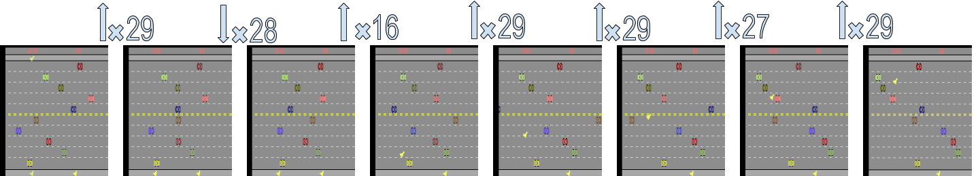
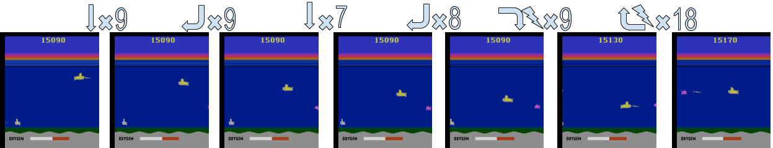
Action Repetition: Motivation

Slide 74
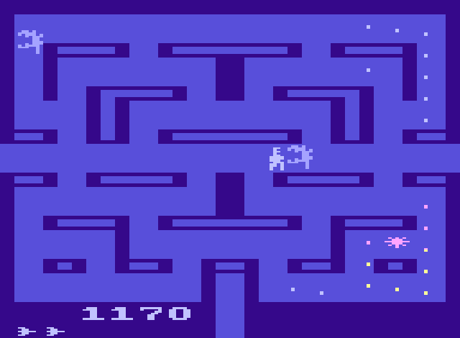
More on Dynamic Repetition
Decide not just the action but also how long you want to execute it
Macro Actions composed of repetitive primitive actions of different length
Policies that change less rapidly
Complex decision making (rapid policy changes) only when required
A primitive setup for temporal abstraction in the policy space

Slide 75
FiGAR: Fine Grained Action Repetition
A lightweight framework
Observations from environment are sufficient not only for predicting actions but their persistence
Can be used for extending any DRL algorithm (such as A3C, DDPG, TRPO) which explicitly maintains a policy
The crux of the idea is to modify the objective function of original DRL algorithm to learn the action repetition distribution jointly

Slide 76
FiGAR-A3C
is realized using a neural network f_{θa}
f_{θx} is the neural network which realizes action repetition distribution
Final layer is a softmax of size 30 : models multinomial distribution
Size of final layer is maximum number of times we think an agent can repeat an action

Slide 77
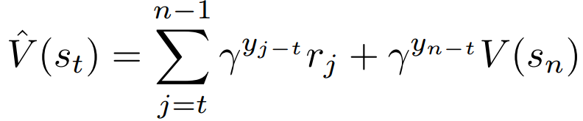
FiGAR-A3C
Objective function for Actor:
Objective function for critic is same except:

Slide 78
Results
Evaluation is done on 33 Atari 2600 games
Also include experiments on
Mujoco Simulated physics tasks domain, extending the TRPO algorithm
The TORCS racing cars domain, extending the DDPG algorithm

Slide 79
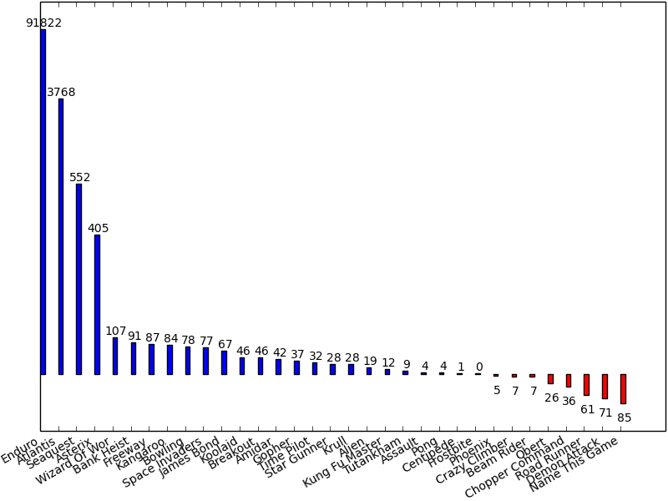
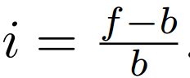
Results: Gameplay performance on Atari
Percentage improvement over baseline A3C algorithm
i is % improvement
f is figar’s average score
b is baseline’s score

Slide 80
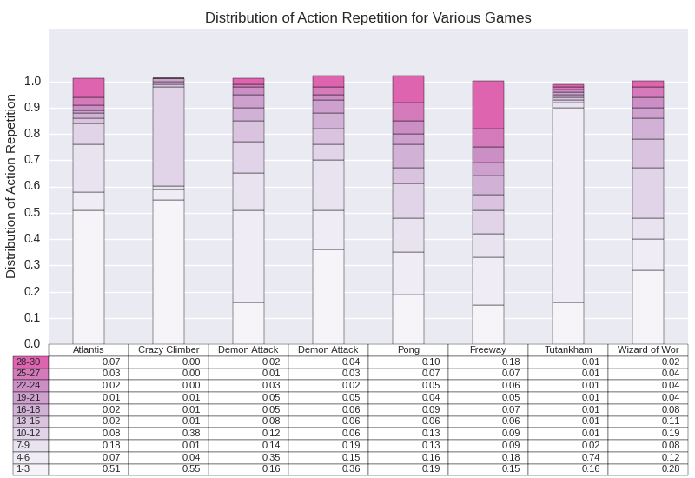
Results: Distribution of Action Repetition

Slide 81
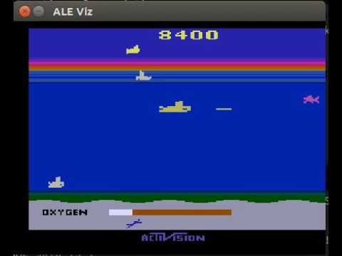
Results: Gameplay on Seaquest

Slide 82
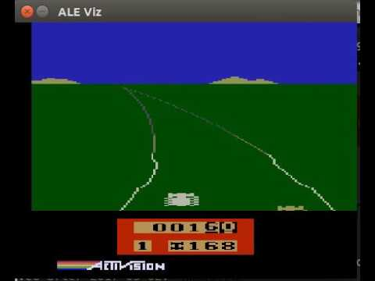
Results: Gameplay on Enduro

Slide 83
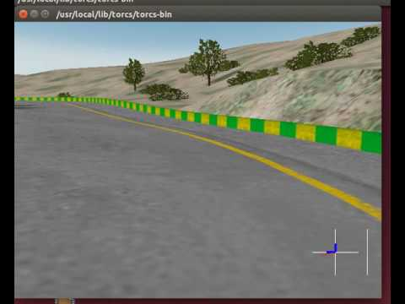
Results: Gameplay on TORCS

Slide 84
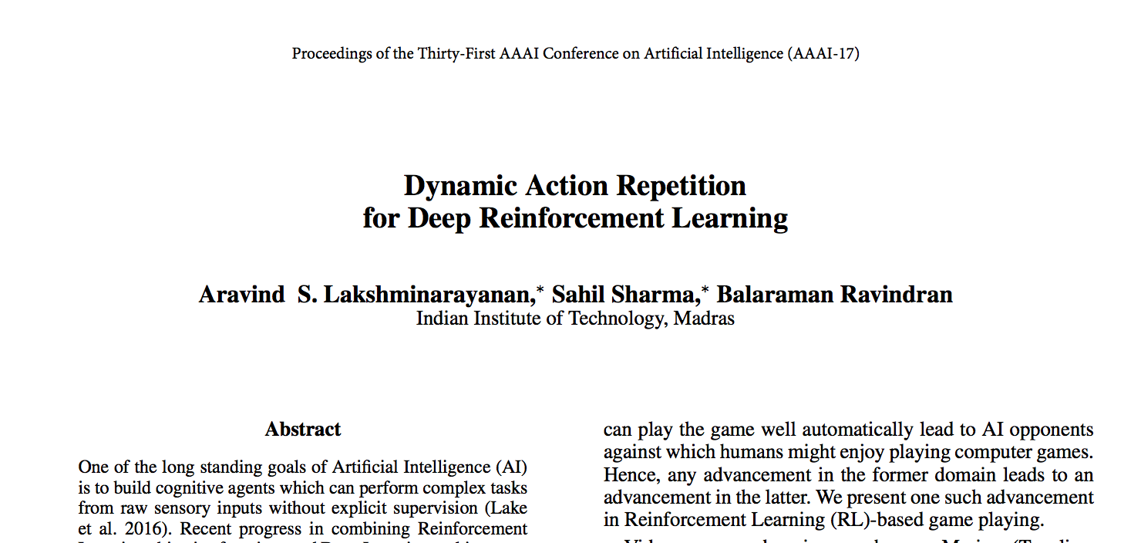

Slide 85
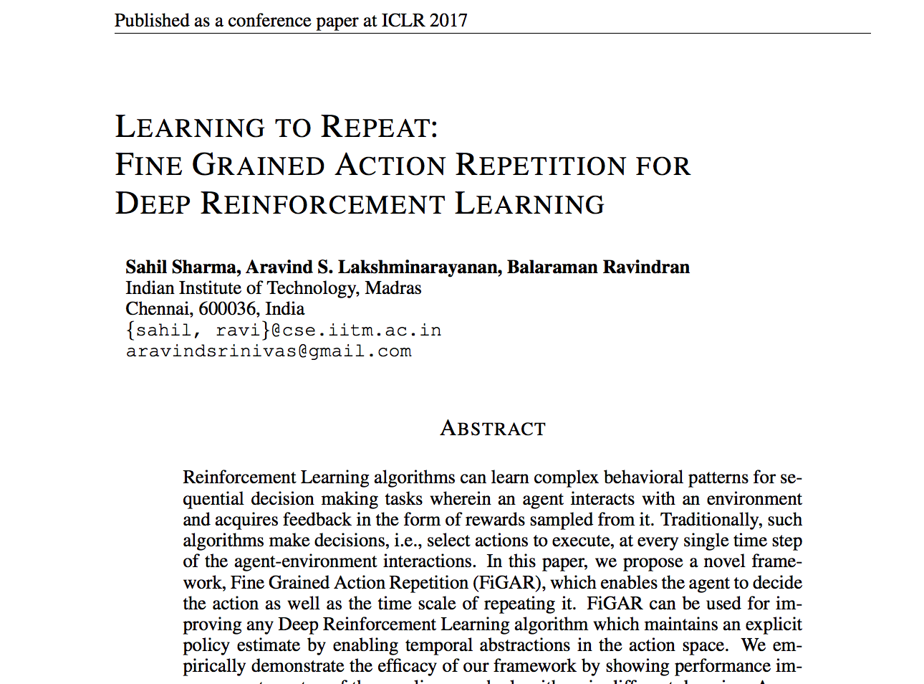

Slide 86
A2T: Attend, Adapt, Transfer
R. Janardhanan, Aravind Srinivas L.,
P. Prasanna, Mitesh Khapra,
B. Ravindran
ICLR 2017

Slide 87
Attention Mechanism
Attention mechanism helps to pick out salient information from clutter and pursue one thought at a time
The importance is assigned based on the output being generated
Performing the task with a large context without confusion

Slide 88
Transfer Learning
Motivation: Speed up the learning on a new task by using past experiences on related tasks
Fundamental problem in AI since learning from scratch by exploring on every new problem is infeasible
All works so far consider the case of transferring from a related source task
How do we identify if a source task is suitable/appropriate and where it is appropriate?
How do we prevent negative transfer?
Transfer slowing down the learning when compared to learning from scratch)

Slide 89
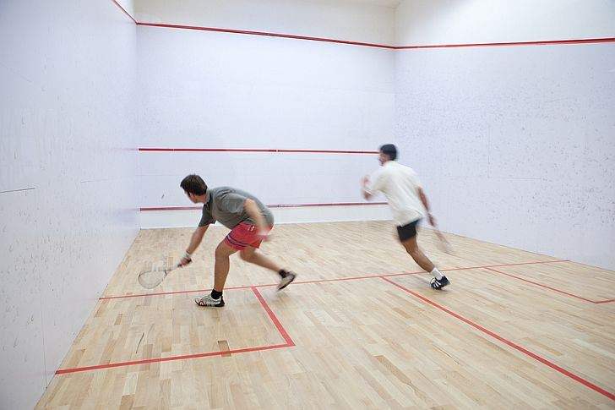
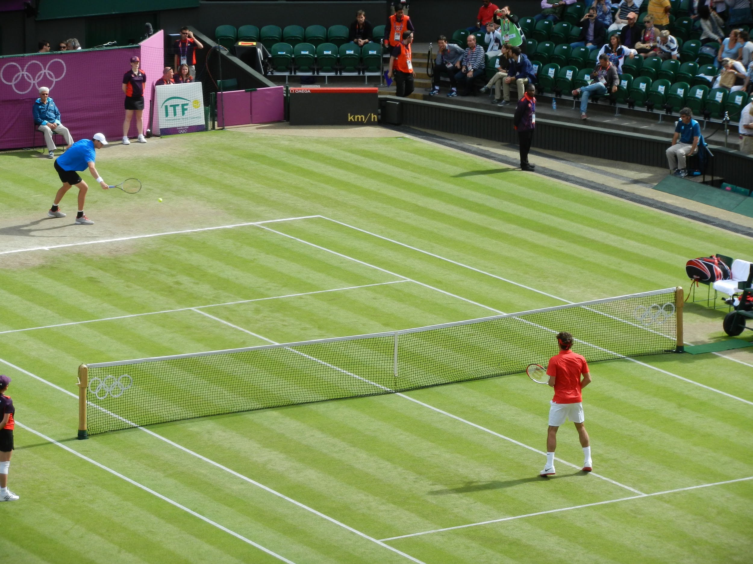


Transfer

Slide 90


Selective Transfer
Backhand >> Forehand
Forehand >> Backhand

Slide 91
Transfer Learning
Motivation: Speed up the learning on a new task by using past experiences on related tasks
Fundamental problem in AI since learning from scratch by exploring on every new problem is infeasible
All works so far consider the case of transferring from a related source task
How do we identify if a source task is suitable/appropriate and where it is appropriate?
How do we prevent negative transfer?
Transfer slowing down the learning when compared to learning from scratch

Slide 92
Transfer Learning + Attention
Mitigate Negative Transfer
Perform Selective Transfer specific to the state
Learn from experience which source tasks are “related” and to what extent
Together, a mechanism to transfer selectively while minimizing negative transfer and identify if a source task is related to a target task or not
Currently proposed for tasks in the same state space

Slide 93

A2T - Architecture

Slide 94
A2T - Architecture
Attend to specific
policies
Selective
Transfer

Slide 95
A2T - Architecture
Avoid
Negative
Transfer

Slide 96
Experiments
Positive Transfer Source task - partial expert on Pong, target : to learn Pong
Negative Transfer i) Negative expert trained by reward functions flipped on Pong ii) Expert network on Freeway (game with similar reward scale as Pong)
Selective Transfer based on state-space Experts trained by blurring selective regions of state-space
Selective Transfer with one positive and one negative expert

Slide 97

Results - Positive Transfer
Source Task - Partial expert on Pong (12/21)
A2T can exploit such an
expert to learn much
faster than learning
without prior knowledge.

Slide 98

Results - Negative Transfer - (i)
Target task: Pong
Source task 1: Expert on Pong
Source task 2: Expert on Freeway
A2T with both source tasks > A2T with base network and source 2 network ~ Learning from scratch > Fine-tuning negative expert.

Slide 99

Results - Negative Transfer (ii)
Target task: Pong
Source task 1: Expert (perfect, partial) on Pong
Source task 2: Expert on Pong with flipped rewards
A2T with perfect, negative > A2T with partial, negative > A2T with negative ~ Learning from scratch > Fine-tuning negative expert

Slide 100


Attention Visualization -1

Slide 101


Blurring - Selective Transfer
Simulate the Forehand/Backhand example in Pong
Blur a quadrant of the screen where you want the agent to be weak at
Upper quadrant - Backhand, Lower quadrant - Forehand (Analogy)
Expert-1: Trained by blurring upper quadrant, Expert -2 : Trained with blurred lower quadrant
Goal of Attention: Focus on expert-1 when ball is in the lower quadrant and on expert-2 when the ball is in the upper quadrant

Slide 102



Attention Visualization -2

Slide 103


Slide 104
Conclusions
General paradigm for transfer with attention proposed
Flexible to transfer from a helpful source task, avoid negative transfer from a harmful source task
Can learn through experience among source tasks to focus on the related (helpful) ones and ignore the harmful (negative) ones
Can learn to select source tasks based on the requirement of the state (Blurring experiments)

Slide 105
Hierarchical Reinforcement Learning using Spatio-Temporal Abstractions and Deep Neural Networks
Aravind Srinivas L, K. Ramnandan,
Peeyush Kumar, Vimal Mathew,
B. Ravindran
ICML 2016 Workshop on Abstractions in RL

Slide 106
HRL with PCCA+ and Deep Neural Networks
MDP Segmentation to discover state-space abstractions
Perron Cluster Analysis (PCCA+) used to discover abstractions
Metastability Approach
Options arise by hill climbing naturally
HRL algorithms used for control policy

Slide 107


Abstractions

Slide 108



Options (hill climbing on the membership)
Go from Room 1
to Room 2
Three Room World
Membership Function plot
Termination function plot

Slide 109

Pipeline without Function Approximation

Slide 110

Modified Pipeline after Function Approximation

Slide 111

Video Prediction Architecture (Oh et al 2015)

Slide 112

Seaquest
Large and complex
State- 210 x 160 pixels
Requires planning and object detection with generalization to unseen state features
Serious challenge in terms of scalability of the PCCA+HRL pipeline

Slide 113

Option Discovery in Seaquest

Slide 114

HRL in Seaquest

Slide 115


Slide 116
Challenges
Major bottleneck : Transition model for the PCCA+ framework
Transition model on aggregated states - A heuristic rather than a scalable solution
Deep spatio-temporal abstraction framework
Sparsity on aggregated state transition matrix
Hierarchical Model Learning
Transfer Learning using learned options

Slide 117
THANK YOU
FiGAR: https://openreview.net/forum?id=B1GOWV5eg
A2T: https://openreview.net/forum?id=Sy6iJDqlx
Hierarchical Reinforcement Learning using Spatio-Temporal Abstractions and Deep Neural Networks: arXiv:1605.05359
http://www.cse.iitm.ac.in/~ravi

